Slide 1
Secure Web Programming
Lecture 7 internet/web security
Amanda.Lunt@utas.edu.au
Soonja.Yeom@utas.edu.au

Slide 2
Topics
Secure Web Programming
Week13
Review
Basic Web Programming
Web Security
Adv. Web Programming
Fundamentals – protocol, CS model, etc.
HTTP Protocols, Storage
Advanced Web Applications
Human Computer Interaction with Web Page Design
Security Issues and Technologies
Session management
Client-side Scripting Language and Document Object Model
Secure Programming and Users
Common Gateway Interface
Server-side Scripting Language and Privilege configuration
Encryption and Authentication
Advanced Security Issues

Slide 3
Review: HTTP messages
Text messages with a set format –contain all of the communication between client and server
Request message (sent by client)
Response message (sent by server)
Message structure is same for both request and response.
Request message
Response message
Called the request line – 3 parts
Method (e.g. GET, POST)
Uri of request resource
HTTP version being used
Initial Line
Called the status line – 3 parts
HTTP version
Response code
Response phrase
Contain information that allows the client to:
Provide information about itself to the server
Give additional details about the nature of the request that the client is making
Allow the client to have greater control over how its request is proceed and how a response is returned by the server or intermediary
Headers
Contain information about such things as:
the media type of the content sent to the recipient
a new URL that the server is instructing the client to use in place of the one the client initially requested
cookies that the client should store
Blank Line
May contain data that has been submitted from a form
Optional Contents
The actual contents of the resource requested (e.g. the html code)

Slide 4
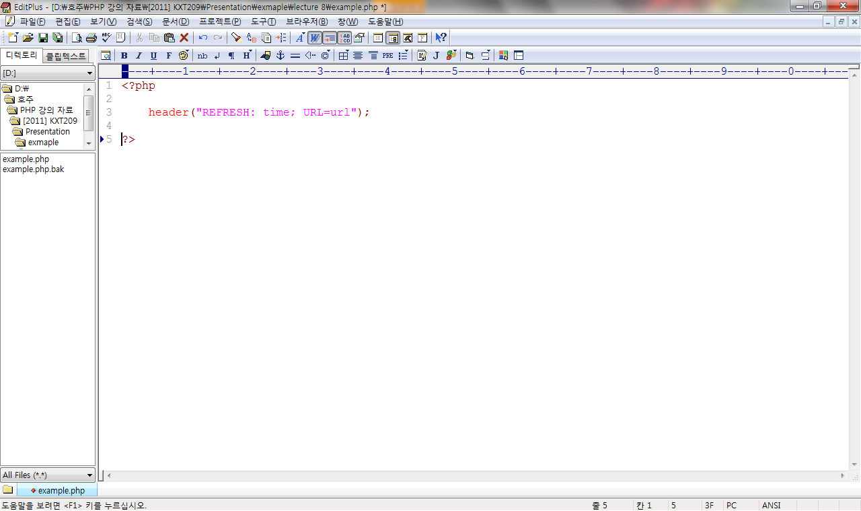
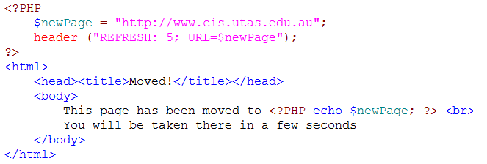
Review: Refresh Header
the refresh header forces the browser to load a new page after a set period of time
time is specified in seconds
URL may be on this site, or another site
example

Slide 5
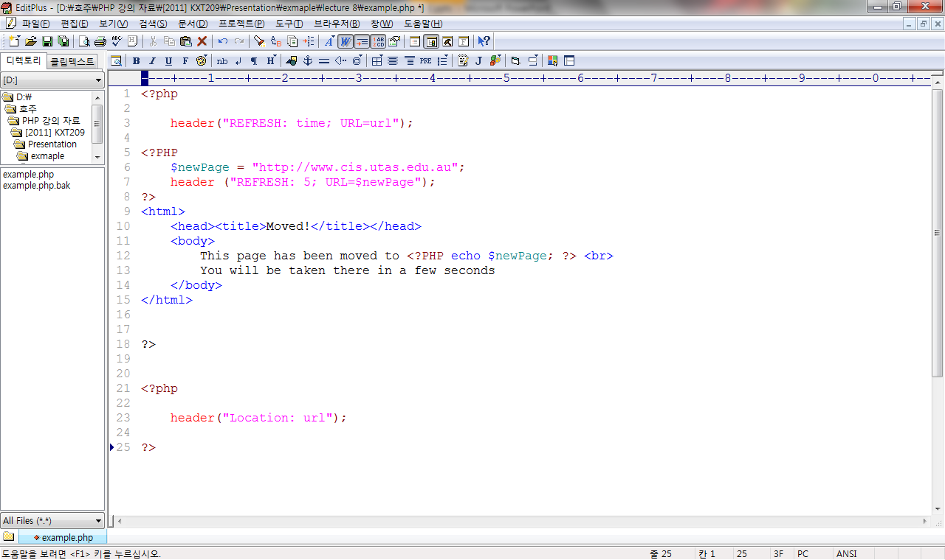
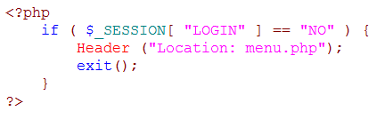
Review: Location Header
the location header forces the browser to go to a new page immediately
compared to refresh
you can use HTML and other content on pages that are to be refreshed
no point using any HTML content on pages redirected with a location header
example

Slide 6
Computer Security
Internet/Web security

Slide 7
Goals
Confidentiality (C),
Integrity (I),
Availability (A), and
Authentication (A)

Slide 8
What is Computer Security?
Confidentiality (C)
“assets of a computing system are accessible only by authorised parties” Pfleeger
Integrity (I)
‘Every piece of data is as the last authorized modifier left it” Schneier,
Availability (A)
“an attacker can’t prevent legitimate users from having reasonable access to their systems” Schneier

Slide 9
What is Computer Security?
Authentication
Genuinely from source
Cannot be refuted
Non repudiation
Cannot be re-used
No replay attacks
Not possible to forge

Slide 10
What is Computer Security?
Authentication is hard in the analogue world
Specialists try to determine if authentication genuine
Authentication is hard in the digital world too
No perfect solution

Slide 11
Security Issues and Technology
The development of the Internet created innumerable new opportunities for personal interaction and entrepreneurial ventures
Problem!
Internet is not free from risks and cyber criminalities
Internet is an adversarial environment where attacks can be easy, inexpensive and may be hard to prevent, detect or trace -> So there are many opportunities for attackers
Adeyinka, Olalekan. "Internet attack methods and internet security technology." Modeling & Simulation, 2008. AICMS

Slide 12
Web Application Security Risks
Rank | Vulnerability
1 | Injection
2 | Broken Authentication and Session Management
3 | Cross-Site Scripting (XSS)
4 | Insecure Direct Object References
5 | Security Misconfiguration
6 | Sensitive Data Exposure
7 | Missing Function Level Access Control
8 | Cross-Site Request Forgery (CSRF)
9 | Using Components with Known Vulnerabilities
10 | Unvalidated Redirects and Forwards
Top 10 most critical
web application
security Risks (2013)
https://www.owasp.org/index.php/Top_10_2013-Top_10

Slide 13
Web threats -2016 (1)
Mobile devices & IoT
Web threats
Social media, scams, & email threats
Targeted attacks
Spear phishing, intellectual property theft
Data breaches & privacy
Cloud & infrastructure
DDos and Botnets
https://www.symantec.com/security-center/threat-report

Slide 14
Web threats -2016 (2)
Web attacks, toolkits, exploiting vulnerabilities online
Problematic plugins
Flash
Exploiting plugins for web servers
Infection by injection
Malicious ads
Malvertising
Cybersecurity challenges
SSL/TLS
Encryption
https://www.symantec.com/security-center/threat-report

Slide 15
Security Risks - 2017
Verify for security early and often (the most important)
Parameterise queries
Encode data
Validate all inputs
Implement identity and authentication controls
Protect data
Implement logging and intrusion detection
Error and exception handling (least important)
https://www.owasp.org/

Slide 16
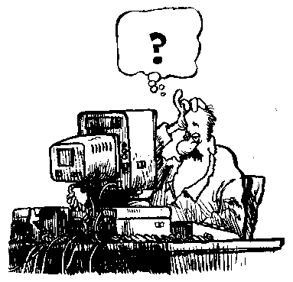
Secure Web application
Building secure web application is very difficult
Unsecure sites
provide many opportunities for attackers
are impossible to identify all the vulnerabilities
comprise of small mistakes

Slide 17
Various types of attacks
Three common attacks - how to prevent it
Phishing attacks
Fool the users
Network attacks
Attack the connection (e.g. steal password)
SQL injection attacks
Attack the server or browser (e.g. sql injection, StoredXSS, ReflectedXSS)
Other attacks

Slide 18
Phishing Attacks
The basic idea of phishing attacks is fooling users:
The following steps represent the example of phishing attacks:
Attract users to visit an “fake” website
Convince the users that the “fake” website is reliable site
Trick the user into disclosing personal information
Now, we will learn how these steps are possible

Slide 19
How to attract users?
Sending spam emails
Redirecting legitimate traffic
Infected machine
compromise user's machine through other mechanisms
modify "hosts" file that maps from host names to network addresses
Legitimate traffic then gets redirected to the attack site

Slide 20
How to convince (trick) the user
How to spoof the legitimate site (e.g. bank website or paypal)
Copy HTML
Include images from legitimate web site
Many links refer back to the legitimate web site
After collecting login info, log user in to legitimate site, redirect to legitimate site
User has no idea that password has been stolen

Slide 21
Various types of Phishing attacks
Malware Based Phishing
Web Trojans
Host File Poisoning
Data Theft
DNS-Based Phishing (“Pharming”)
Search Engine Phishing

Slide 22
Phishing attacks: Solutions
How to prevent the phishing attacks:
Guard against spam mail
Enter personal information only in secure web sites
Do not click the links, open the email or download files, which is provided by unknown users
Protect the computer by using firewall, anti-virus software

Slide 23
Other Security Problems
As well as transport security, there are many other ways that sensitive information can be put at risk
poorly-designed web sites may leave sensitive information visible
poorly-written CGI/PHP scripts that are "attackable"
poorly-configured web servers that are open to attack
bugs in web server code that are discovered and then exploited

Slide 24
Various types of attacks
We will learn several modes of attacks and how to prevent those attacks:
Phishing attacks
Fool the users
Network attacks
Attack the connection
Code injection attacks
Attack the server or browser (e.g. sql injection, StoredXSS, ReflectedXSS)
Other attacks….

Slide 25
Network attacks
Attack the network communication between browser and server
Eavesdropping
Attacker has access to data paths in your network to interpret/read the traffic
Data Modification (Modify packets)
Attacker modifies the data in the packet without the knowledge of the sender or receiver
Identity Spoofing (IP Address Spoofing)
Attacker masquerades as a trusted host to modify, reroute, or delete your data.
Sniffer Attack
Attacker read, monitor, and capture the network data exchanges and read network packets by using sniffer, which is an application

Slide 26
Network attacks (2)
Session hijacking
There are three methods used to do a session hijack:
Session fixation
Attacker fixate another user’s session identifier
Session sidejacking
Attacker uses packet sniffing to monitors, captures, controls the network traffic between two parties to steal the session
Cross-site scripting
Attacker inject client-side script into web pages, which are viewed by other users

Slide 27
Preventing the network attacks (1)
Encryption is a technique transforming a message such that it is unintelligible
a cryptographic algorithm, also called a cipher, is used to encode the message
a key is used to complete the encoding process
the encrypted message must be decrypted to make it readable again
a key is used to decrypt the message
if the wrong key is used, the decrypted message will be different to the original message

Slide 28
Preventing the network attacks (1)
To prevent and detect network attacks
Encryption Techniques
There are two common encryption techniques
Symmetric Key Encryption
Public Key (Asymmetric Key) Encryption

Slide 29
Symmetric Key Encryption
It is the traditional key encryption technique
Use the same key to encrypt and decrypt the message
ajsdhj
asdklajs
original
message
key
encrypted
message
original
message
key

Slide 30
Symmetric Key Encryption
Advantage: The speed is fast (in both encoding and decoding)
Disadvantage:
Key distribution issue : The key must be kept secure. What if attacker find out the key when user exchange the key to others? You need to exchange with meeting in person

Slide 31
Public-Key (Asymmetric Key) Encryption
Solve the problem of the symmetric encryption
different keys must be used to encrypt and decrypt the message
the public key is publicly available
the private key is kept secret
encrypted
message
original
message
public
key
private
key
original
message
ajsdhj
asdklajs

Slide 32
Public-Key (Asymmetric Key) Encryption
Public-Key(Asymmetric key) Encryption Process:
One encrypt the message with the public key and send it to the other
The other recipient uses the private key to decrypt the message.
Even if a third party gets the message, they are unable to decrypt it without the private key

Slide 33
Public-Key (Asymmetric Key) Encryption
ajsdhj
asdklajs
original
message
public
key
encrypted
message
private
key
original
message
Advantage
messages are securer, since the decryption key doesn't need to be shared
Disadvantage
requires greater computation, and hence more CPU power
doesn't prevent misrepresentation

Slide 34
Integrity – one way hashing
a widely used cryptographic hash function
employed in a wide variety of security applications
commonly used to check the integrity of files
widely used to store passwords
Input : a variable-length message
Output : a fixed-length output of 128 bits
satisfy the avalanche effect
a small change in either the key or the plaintext should cause a drastic change in the cipher text
MD5("The quick brown fox jumps over the lazy dog") = 9e107d9d372bb6826bd81d3542a419d6
MD5("The quick brown fox jumps over the lazy dog.") = e4d909c290d0fb1ca068ffaddf22cbd0
Only Full stop added

Slide 35
Algorithms for integrity
Examples
MD5
SHA
Blowfish
Notes:
Key decay

Slide 36
<?php $hashed_password = crypt('mypassword');
// let the salt be automatically generated if (hash_equals($hashed_password, crypt($user_input, $hashed_password))) { echo "Password verified!"; } ?>
http://php.net/manual/en/function.crypt.php
Notes:
/* You should pass the entire results of crypt() as the salt for comparing a password, to avoid problems when different hashing algorithms are used. (As it says above, standard DES-based password hashing uses a 2-character salt, but MD5-based hashing uses 12.) */
Data Encryption Standard (DES)
Salt(cryptography): a salt is random data that is used as an additional input to a one-way function that “hashes” a password or passphrase.

Slide 37
Algorithms
$hashed_password = crypt('mypassword');
// let the salt be automatically generated if (hash_equals($hashed_password, crypt($user_input, $hashed_password))) { echo "Password verified!"; }

Slide 38
Thank you
Any Questions

